Slide 1
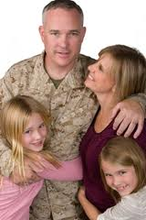
Securing the Yellow Ribbon: Caring for our Veterans and their Families During Phases of Deployment
Mark E. Swerdlik
Illinois State University
Notes:
SEE TALKING POINTS

Slide 2
Overview of This Evenings Talk
Background Statistics
Changes in the U.S. Military
Phases of Deployment
Homecomings from Wars in 20th and Early 21st Century
Mental Health Challenges of Soldiers and for Families
Impact of Deployment on Children
Review of Strategies to Address Reintegration Challenges
Take Home Points
Notes:
Here is an overview of the subtopics of this evenings talk. My goal is to summarize the most current psychological research on each of these subtopics highlighting studies ISU students and faculty have conducted.

Slide 3
National Guard Collaborators (2007-present)
2nd LT. Justin Anweiler, Former Yellow Ribbon Manager
LT. Col (ret) Eric Murray (now Chief of The Service Member and Family support Services)
Colonel Joseph Schweickert
CPT Jenny Nielson, Yellow Ribbon Manager
CPT O. Hines, Wounded Warrior Ministry Chaplain
Juliann Steinbeigle, Director of Psychological
Health
Colonel Heard-Thompson (ret)
Notes:
At the outset I would like to recognize our National Guard Collaborators several of who are here this evening. Ask to please stand and be recognized.

Slide 4
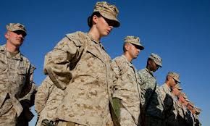
Thank You for Your Service!
Notes:
Now we would like to recognize other service members including those currently in the military, veterans, and ROTC members –I ask you each to please stand and be recognized?
Please join me in thanking them for their service to our country.

Slide 5
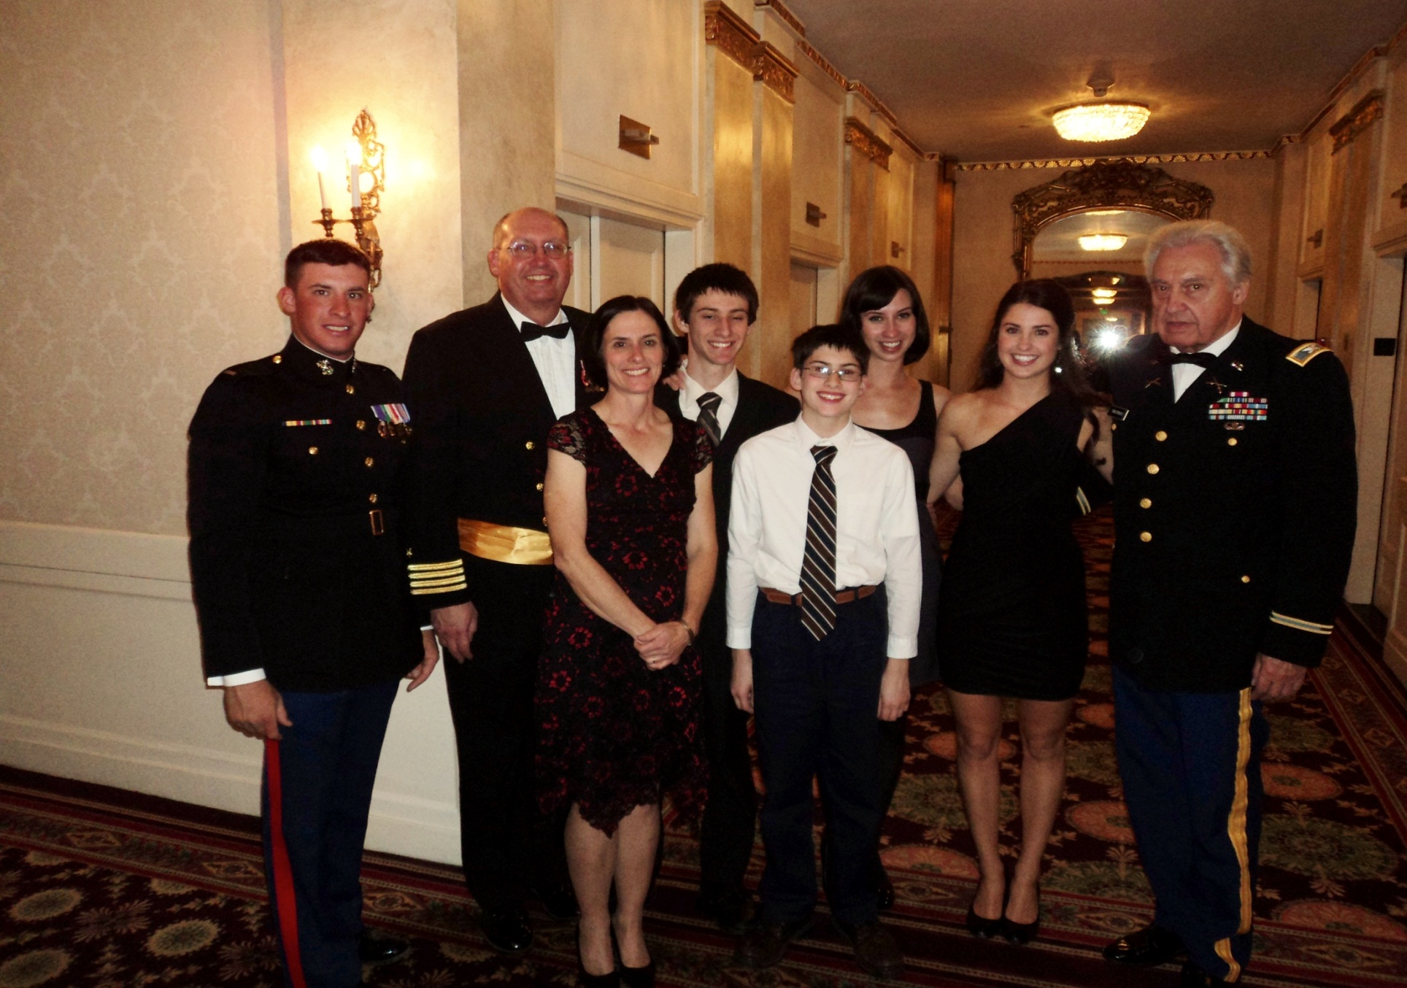
Thank You, Families for your Sacrifices
Notes:
We also acknowledge that families of soldiers sacrifice as well. Representing families of service members I ask Scott and Amy Christenson and members of their family to please stand. Scott and Amy are parents of Robbie at far left in the picture) who is currently serving in the Marine Corp, . Scott (2nd from the left) is also in the U.S. Navy Reserves and his father (Robbie’s grandfather) at the far right is a Navy veteran.
May I also ask other family members in the audience who have a loved one in the military to please stand.
Although only 1% of Americans serve in the military, members of their families serve and sacrifice as well
Please join me in recognizing these family members as we thank each of them for their sacrifices for our country

Slide 6
Support provided by grants from the National Guard Association of Illinois (NGAI)
Notes:
Thanks also to the National Guard Association of Illinois for funding the research conducted by our department which I am going to highlight this evening . The NGAI is an organization for the Soldiers, Airmen and Families of the Illinois National Guard which advocates within the state and nationally to promote those issues which will enhance the combat readiness of the ILNG and cares for the well being of the ILNG soldiers and airmen and their families.

Slide 7
ISU Collaborators
Faculty Colleagues
Jef Kahn, Ph.D.
Steven Landau, Ph.D.
Adena B. Meyers, Ph.D.
W. Joel Schneider, Ph.D.
Graduate Students
James Allen
Silas Dick
Jennifer Jensen
Jacob Linnell
Sara Rubin
Undergraduates
Kristina Gluth
Jesse DiSandro (Cadet ROTC, ISU)
Notes:
These are my psychology department colleagues, graduate and undergraduate students, some with us this evening, who have been involved in conducting this collaborative research with the Illinois National Guard.

Slide 8
Did you know?
Over 2 million U.S, military service members deployed in recent wars
Military dependents (spouses and children) outnumber military members
Nearly half of military service members have children numbering close to 2 million
Notes:
Here are a few statistics that provide some context for this evening’s talk.
Over 2 million U.S, military service members, have been deployed to engage in military operations in our most recent wars in Iraq and Afghanistan
Number of military dependents (spouses and children) outnumber military members.
Nearly half (43%) of military service members have children with 1.9 million children from newborn to age 18 and 1.3 million are school age. Since 2001, approximately 2 million children have experienced a parental deployment.

Slide 9
Did you know?
Current military families have experienced the longest , most frequent, and most cumulative number of deployments in U.S. history
Typical length of deployments is 12-15 months
Typical number of deployments is 2.2
Notes:
Current military families have experienced the longest , most frequent, and most cumulative number of deployments in U.S. history-research suggests it is not the number of deployments but their cumulative length that have the most significant impact on children and families.
Typical length of deployments is 12-15 months due to lengthier trainings and periods away from home for staging and extensions.
Typical number of deployments is 2.2 with some active military members having up to five deployments
----

Slide 10
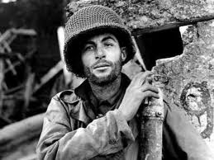
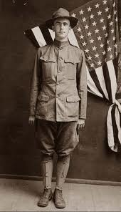
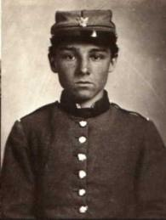
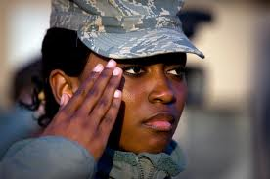
Changes in the U.S. Military
Notes:
Changes in the U.S. military have increased the risk factors commonly experienced by military families
Largely as a result of the history of conscription or the draft through the end of the Vietnam War, the majority of the military was comprised of single young men. As the war in Viet Nam came to a close, several things occurred.
First the size of the active army decreased dramatically (from approximately 3 million to 1.5 million service members).
Second, the conscripted military gave way to a military force comprised entirely of volunteers.
With this shift came an increase in the diversity and numbers of married service members. Currently 71% of officers and 40% of enlisted personnel are married, 42% of all service members have children,
and woman make up 14% of the total military force which means mothers are being deployed which increases risk factors for families due to societal expectations related to the role of women in families as primary caretakers.

Slide 11
Phases of Deployment
Pre-Deployment
Deployment
Sustainment
Anticipatory Return
Reunion /Homecoming
Reintegration
Notes:
We have come to understand that deployment is not an event but a process with generally predictable phases for military families. Defining deployment as a process that potentially begins before the service member departs and continues beyond his or her return allows one to consider the multiple influences deployment may have on family life.
The Pre-deployment stage typically begins when the service member receives notification of an impending deployment, The ensuing time before the actual departure date may be a busy time, with the service member balancing a vastly increased workload as well as family preparation responsibilities (such as insurance, will), and reactions such as what will life be like for the family with the soldier absent. Most report significant stress anticipating the changes to family life.
The Deployment stage specifically spans the period from the date of departure to the end of the first month of absence and may involve initial adjustments to altered routines (such as not have dinner together, who fixes things around the house) as well as establishing patterns of communication( e-mail, cell phone) with the deployed service member.
The sustainment stage lasts from the end of the first month through the beginning of the final month of deployment during which time new routines may be established such as completing daily chores, paying bills, routines associated with raising the children-who reads the bedtime story) .
The Anticipatory Return stage is defined as time preceding a service member’s homecoming and is typically characterized by a shift in family activities in preparation for the service members return (typically a great deal of excitement and anticipation.
The Reunion Stage also referred to as Homecoming begins when the service member arrives home and typically characterized by a great deal of euphoria.
The Reintegration stage typically lasts from three to six months and may in fact last for several years. During this phase families often face the tasks of renegotiating roles and areas of responsibility and establishing new routines. Spouse has learned how to run a household alone and do the work of both people. Spouse left behind may have have found they enjoy taking care of things like paying the bills, and feel they do a better job of it. There needs to a period of “re-sorting” of responsibilities of the household and how the workload is divided. Integrating the service member back into family routines can be challenging for young children who might not remember the deployed service member. Children have also adjusted to just one parent disciplining them. Also a great deal of stress associated with this stage.

Slide 12
Notes:
Military briefs to soldiers on stresses associated with particularly the deployment and reintegration phases use the analogy of a family in a canoe on a smooth lake.

Slide 13
Homecomings in 20th and 21st Century
World War I
World War II
Vietnam War
Operations Iraqi and Enduring Freedom
Notes:
One of the areas we have been involved in our collaborative research with the Illinois National Guard focuses on the reintegration phase of deployment. Research has indicated that Homecoming or reunion is part of this reintegration experience the final phase of deployment and has an impact on successful reintegration. We see some differences in the Homecoming experiences of soldiers from different wars in the 20th and 21st century.

Slide 14
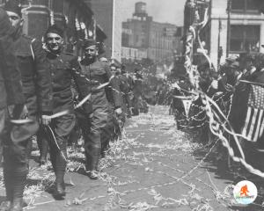
Homecoming: World War I
http://www.youtube.com/watch?v=QBzX9nZ4xBc
Notes:
During what was referred to as the Great War of 1914-1918 many soldiers returned home with invisible wounds which included suffering from what was then called “ shell shock” also referred to as “war neurosis" or "combat stress" and now recognized as Post Traumatic Stress Disorder or PTSD, Typically, there were public Homecoming events upon their return such as the one depicted in this video.
However, after the parades there were no programs or efforts to facilitate the reintegration of WWI soliders into their civilian lives to help them cope with their mental health challenges.

Slide 16
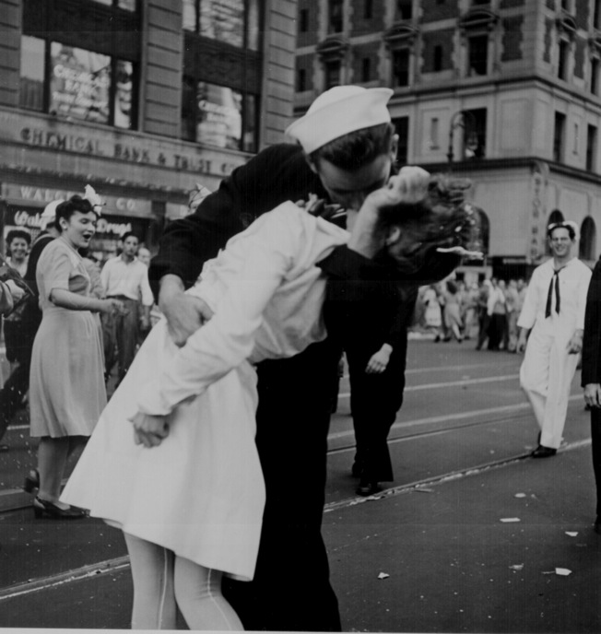
Homecoming: World War II
Higher combat exposure lead to:
Long-term physical and mental health implications
56% of World War II veterans who experienced heavy combat died by age 65
High percentage with PTSD
Notes:
STUDIES OF WORLD WAR II VETERANS HAVE found THAT higher combat exposure was associated with
Long-term physical and mental health challenges
Harvard University study found 56% of World War II veterans who experienced heavy combat died by age 65
High percentage returned with what was called at the time “not yet diagnosed, nervous” which was later changed to what with we now call Post-Traumatic Stress Syndrome or PTSD.
MOST OF THESE VETERANS SUFFERNG FROM THESE SYMPTOMS DID NOT SEEK MENTAL HEALTH SERVICES.

Slide 17
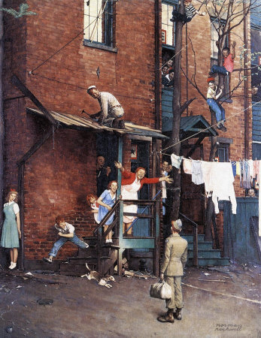
Homecoming: World War II
Notes:
Despite the significant impact combat had on WWII veterans and although there were certainly Homecoming events, both formal (as the New York Times Square Welcome parade pictured in the previous slide-recall my father in law, a WWII veteran, talking about the Homecoming celebrations in Chicago and how he couldn’t pay for his own drink in a bar or a meal in a restaurant and the euphoria that characterized these public Homecomings) and informal Homecomings such as this one depicted in a famous Norman Rockwell Saturday Post cover, there existed no formal reintegration program to assist those returning from war in readjusting back into civilian life. Many of us may recall our fathers, grandfathers, uncles, and other family members who never talked about their experiences in the war. We assumed they had adjusted but came to learn in their old age that many lived with many secret demons that only were expressed in their later years but impacted them throughout their life

Slide 18
Homecoming: Viet Nam War
Notes:
Other than Viet Nam Prisoner of War release receptions depicted in this famous Pulitzer Prize winning photo., there were few formal community homecoming events held for the Viet Nam war veteran nor were there formal reintegration programs to facilitate their adjustment back into civilian society. Many returned with what was formally referred to as Post-Traumatic Stress Syndrome or PTSD during this war.

Slide 19
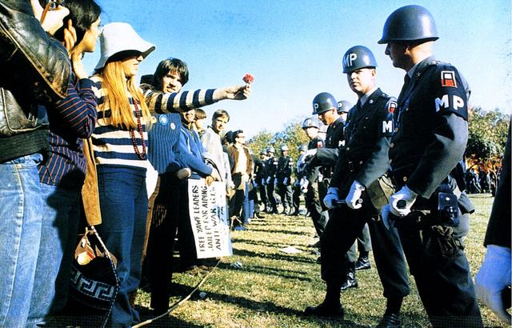
Homecoming: Viet Nam War
Notes:
There exists much mythology around homecomings during the Viet Nam war in terms of confrontations with protesters and reports of protestors spitting at returning soldiers. However, it is clear that more formal community sponsored welcome home events such as those experienced by the WW I and WWII veteran thanking the Viet Nam veterans for their service did not occur until over a half a century later.

Slide 20
Homecoming: Post 9/11 Wars
Notes:
United States has been involved for more than a decade in wars in Iraq and Afghanistan leading to many good-byes but also thankfully many homecomings

Slide 21
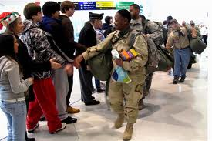
Homecoming: Post 9/11 Wars
<http://www.youtube.com/watch?v=NveizwAMhpY>
Notes:
Due to much different societal attitudes towards the all volunteer military and supported by social science research that suggests that the type of Homecomings provided to our military service members does have implications for successful reintegration, homecomings have been much different for our veterans of the wars in Iraq and Afghanistan. Here’s a few examples.
PLAY VIDEO (4 MINUTES)

Slide 22
Notes:
Those are certainly expressions of pure joy!

Slide 23
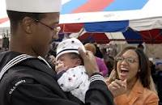
Reintegration Challenges
Family Issues
Job and work issues
Personal reactions (feeling like oneself again)
Being able to adjust to routines of daily living
Notes:
SEE ATTACHED-Many soldiers dream of their reunion with their families but many common challenges await our veterans after the Homecoming event depicted in the videos. Important to normalize these challenges. Research has identified four areas of challenge:
1. Family Issues-e.g., establishing new routines when return from war that have gone through considerable change since the departure of the service member, reestablishing communication (may feel like strangers) with family members including children which may have a particularly difficult time having the service member reintegrated into routines as they may have changed significantly in the time the service member was deployed.
2. Job and work issues-readjusting back into civilian employment-in war a soldier may have been responsible for millions of dollars worth of equipment-in civilian job may have much less responsibility
3. Personal reactions (feeling like oneself again)-typical reactions may include physical symptoms such as trouble sleeping, upset stomach, headaches, sweating, rapid heartbeat or breathing, feelings of numbness or inability to feel happy, along with mental or emotional symptoms like nightmares, flashbacks, and memories, nervousness, fear, begin easily upset, feelings of rejection, guilt and anger. Upon arrival home feel somewhat out of place, alienated, or have an overall feeling of things being strange. Females tend to feel more anxiety and males more anger. Many veterans report have problems with loud noises or surprises during the first few weeks since they are reminders of the noises of combat. May be problems with driving, as a soldier returning from our recent conflicts may still be looking for suicide bombers or IEDs. In previous wars before jet travel would have time to “decompress and wind down on the return home as they traveled by ship. Currently, soldiers may be home within one or two days after leaving the combat area leaving little time to readjust and prepare for civilian life. Many service members experience these reactions but if after several months the soldier is still not adjusting well and is impacting family relationships, school or work, may be PTSD
4. Being able to adjust back to routines (during deployment have to make few decisions about daily activities did not have to make decisions about -what to eat, what to wear, doing their own laundry,
It is important to normalize these challenges as they occur for all soldiers returning from war and monitor if still not adjusting after several months may represent symptoms of PTSD.
Impact depending on a number of variables including degree of combat exposure, cumulative length of deployments, and financial stress.

Slide 24
Challenges of Reintegration: In their Own Words
Notes:
We have discussed a number of common challenges associated with the reintegration phase of deployment. Here are some soldiers talking about them in their own words.

Slide 25
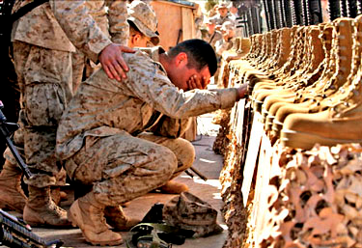
Mental Health Impact of War On Soldiers
PTSD
Depression
Substance abuse
Marital and Family Issues
Suicide
Greater risks associated with:
--National Guard service
-- longer cumulative length of deployments,
--greater combat exposure
--financial problems
Notes:
SEE ATTACHED---ALTHOUGH MOST SOLDIERS MAKE A SATISFACTORY ADJUSTMENT AFTER THEY RETURN HOME COMBAT STRESSES LEAD TO SIGNIFICANT MENTAL HEALTH CHALLENGES FOR MANY. Almost 1 million troops had at least one mental health problem since 2000 and 13-20% of the 2.6 million military personnel serving in Iraq and Afghanistan have had symptoms of PTSD.
Research has found soldiers from the reserve and National Guard experience a disproportionate burden of mental health symptoms following their return from recent conflicts, faring significantly worse than active component soldiers. Up to 42% report mental health issues suggesting a need for further evaluation by three months following their return. PTSD is particularly devastating because veterans will often times self-medicate with drugs and or alcohol to alleviate the symptoms of PTSD. Research suggests that 64-84% of veterans with PTSD will also suffer from life-long alcohol abuse disorders.
Veterans suffering from PTSD which include more chronic flashbacks, nightmares, increased arousal such as feeling on-guard or startling easily and lead to problems in functioning in the family, school, and/or work settings also experience significantly higher rates of marital and familial problems, which often come in the form of domestic violence and child abuse than those without PTSD. These elevated levels of behavioral problems are similar to what we saw with Vietnam veterans. Mental health challenges also include mood disturbances and various forms of anxiety. These veterans do not typically access care.
Potentially because of high symptom levels and inadequate treatment, suicide rates have increased among soldiers and now surpass those in the general population. In fact, currently soldiers are experiencing the highest suicide rate in 26 years of the Medical Department of the Army’s record keeping, and surpass age and gender adjusted rates in the US.
National Guard soldiers have unique circumstances that make the post-deployment period higher risk for emerging mental health issues. They are not stationed on military bases and have fewer built-in social supports, such as easy access to peers, chaplains, family support programs, and military health services. Instead, deactivated National Guard soldiers are dispersed throughout their home states and must rapidly reintegrate back into their civilian communities and jobs. Similar to World War II veterans,
greater risk is associated with more combat exposure but also more cumulative length of deployments and financial problems.

Slide 26
What do Children of Deployed Parents Worry About?
Possible geographic relocation
Safety of their parent
Family restructuring
Integrating deployed parent back into the routine
Financial limitations
Parents getting along
Next deployment
Difficulty finding support outside of the the home
Notes:
As a school psychologist, I am particularly interested in the impact of deployment on children. These children say more hellos and good byes than non-military children and have a lot of practice with SKYPE
What does the research tell us they worry about? They worry about possible geographic relocation (particularly children of National Guard/Reservist where left-behind parent may move to be closer to family), safety of their parent- parental injury or death, about family restructuring and how the renegotiation of roles and fitting the deployed parent back into the routine will impact them, financial limitations, they worry about their parents getting along, and next deployment.
Difficulty finding support outside of the the home as they feel their situation cannot be understood by those in non-military families

Slide 27
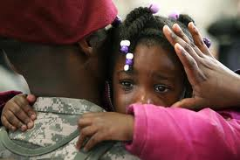
Impact of Deployment on Children
Internalizing symptoms (e.g., depression, anxiety)
Externalizing symptoms (e.g., aggression, oppositional behavior)
Academic adjustment (e.g., grades, achievement test scores)
Peer conflicts
Notes:
A number of studies have investigated the impact of parental deployment on children’s adjustment grouped into four areas—
-internalizing symptoms (such as depression, withdrawal, sleeping and eating problems)
externalizing symptoms (such as oppositional behavior, aggression, rule breaking)
academic adjustment (such as attention problems or decreased academic engaged time, lowered grades and achievement test scores, homework completion)
Peer conflicts (females and adolescents)

Slide 28
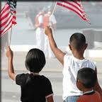
Child Adjustment and Parent Deployment
Resulting Stress and and mental health issues negatively influence the academic, social-emotional, and psychological outcomes of military children
Secondary traumatization
Some military children cope effectively-are resilient
Notes:
Findings Related to Child Adjustment and Parent Deployment
Reviewing studies on military children over time-peacetime, Viet Nam War, Iraq, and Afghanistan, found that mental health issues have become more prevalent for children whose parents are deployed to Iraq and Afghanistan. In fact, Pre-Iraq and Afghanistan mental health disorder prevalence rates were lower than civilian children.
There is a relationship between the prevalence of adjustment problems among military children including academic, social-emotional, and psychological and prolonged and frequent deployments to war zones as compared to children whose parents never went to war.
What are predictors of negative psychological and behavioral health outcomes among military children? The anticipation of a parent being deployed to a war zone, parental separation, frequent moves, the stress level and coping ability of the left-behind parent who now has to raise their children alone and be the sole manager of household responsibilities, represent major factors.
Stress and anxiety of the left-behind parent can be transferred to the child when the remaining parent shares developmentally inappropriate information with the child or his or her own grief, loss, or fear of spousal injury to death.
Military children can also experience what is referred to as second traumatization in which the returning veteran transfers personal war related trauma to their children through for example obsessive retelling of war stories or expressions of guilt for being agents of war violence. Children may internalize frightening experiences of war far removed from their own realities in an effort to identify with the traumatized parent.

Slide 29
Protective Factors
Healthy home environments/caregiver manage personal stress
Stable parental employment and housing condition
Financial stability
Degree of social support
Family recognition of “hero status” of deployed parent
Notes:
Many military children cope effectively we need to investigate what factors contribute to these children being more resilient-Some research suggests these are protective factors- -family cohesiveness,, length of time in residence, stable parental employment, financial stability and fewer depressive symptoms of the parent left-behind
Degree of Social support from family, friends, neighbors, and school personnel
Perceive deployed parent as a “hero”
Schools can be viewed as a “stable place or sanctuary for students”. Not a lot of literature on the role of the school-need more
Jake Linnel, doctoral student in school psychology, is currently conducting his dissertation study on looking at the role of the school as a protective factor deployment.

Slide 30
Approaches to Address Reintegration Challenges
Event-Based Reintegration Programming
Peer Outreach Program
Community Providers
Notes:
So far we have reviewed a number of reintegration challenges for soldiers and their families. There a number of approaches to address these challenges. At ISU, the approaches we have focused our research with the National Guard include the event based together with community provider approaches

Slide 31
Event Based Reintegration Programing: Illinois National Guard Yellow Ribbon Program
Notes:
The Illinois National Guard , along with Minnesota, led the nation in developing and implementing a formal mandatory reintegration program for our National Guard soldiers when they return from war.
The Department of Defense now mandates that all military branches including the National Guard in all 50 states, provide these event based reintegration programs.

Slide 32
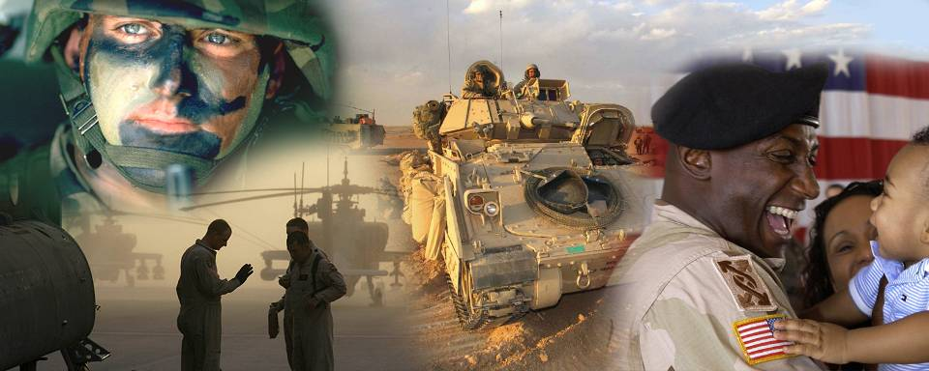
Soldier
Community
Employer
Family
Notes:
The Yellow Ribbon Program views reintegration as 3-legged stool- Soldier is the base or seat of the stool and is supported by three legs-Family, Community, and Employer.
It is a preventative program that provides for families throughout the deployment cycle and for soldiers during reintegration.

Slide 33
Tier I Event/30 Day Program
Purpose: Reconnect soldiers and families with service providers through a round-robin format. Allows for more personal contact with service providers
Conducted Approximately 30 DAYS after Initial Event
Briefing Challenges of Reintegration/Break outs
t
Service Providers Presenting Information
Federal, State, County
Service providers
- VA Vets Center
- County Veteran’s Service Officer
- VA Benefits Representative
- IL Workforce Representative
-Employment/Unemployment (how to look for a job)
-IL Colleges (how to get back into school)
Military Service Providers
- Chaplain
- JAG/Legal
- TriCare Representative
- EtR/FAC
- Nat’l Guard Education Benefits
- Mental Health Specialist
Notes:
Wanted to describe for you a bit about the Yellow Ribbon Program.
Tier I event mandated for soldiers and family members are invited.
A major goal of the day is to create awareness of typical reintegration challenges and “red flags” related to reintegration reactions and how to seek out assistance by increasing awareness of benefits and resources available.
Soldiers also discuss their reintegration experience in smaller groups with same rank peers
Event provides an opportunity to socialize and reconnect with the members of their units.
The day also includes an “Informational Fair” with booths staffed by representatives from various community and veteran agencies that can assist the veteran.

Slide 34
Tier II Event/60 Day Reintegration Training Address Behavioral Issues
Purpose: Provide Resiliency Training.
Conducted Approximately 60 DAYS After Initial Event
Anger Management
Focus Groups
Substance Abuse Prevention
Compulsive Behaviors Prevention
Service Providers
-Alcohol & Drug Abuse Prevention Counselor
-Combat Stress Control
-Chaplain
-Gambling Abuse Counselor
-Law Enforcement
Notes:
60 days after returning home-event provides more in-depth coverage of topics addressed in the Tier I 30 day event and focuses on resiliency training. An unique-series of focus groups addressing skill sets utilizing case study vignettes in a group therapy type format lead by trained mental health counselors, with veterans and their families focus on issues such as anger management, substance abuse and prevention, and risk taking behaviors such as gambling, viewing pornography and suicide,) Illinois is unique being the only state to use these focus groups as part of their reintegration programming. Service providers are also present.

Slide 35
90 Day Reintegration Training
Purpose: Conduct a thorough mental and physical health assessment of combat veterans
Conducted Approximately 90 DAYS After Initial Event
Service Providers
- Medical Readiness
- Mental Health
-Chaplain
-PDHRA Team
Notes:
At three months post-deployment the 90-Day Event is held. The goal is to conduct a thorough mental and physical health assessment of combat veterans. Mandatory for soldiers and not open to family members. Administer formal health screening instrument and have service providers available

Slide 36
Family Reunions
Purpose: To empower and resource families so they can address the effects of combat operational stress and reintegration issues
Conducted approximately 45 Days before Unit returns to the United States
Targeted Audience
Service Providers
-Spouses
-Parents
-Significant Others
-Children
-State Family Readiness program
- State Chaplain
-Tricare Rep
-Marriage and Family Therapist
-VA Benefits/Vets Center
-ESGR/Workforce Center
-County Veteran’s Service Officer
-Parent Educator
Notes:
Family Reunions also represent an integral part of the Yellow Ribbon Event based program. These reunions are held for families including spouses, parents, and significant others of soldiers are invited (POINT TO TARGETED AUDIENCE) approximately 45 days prior to their soldier’s return home. We know that deployment and reintegration impacts the entire family so an effective program must focus on the entire family unit. Goal is to empower families and to prepare them so they can address the effects of combat stress and other reintegration issues (what like when return). Similar to the goals of the 30 day Tier I program the goals center around creating an awareness in family members of some of the predictable reactions to returning home and sensitizing them to potential mental health issues Break out sessions include Reconnecting with their children and spouses, medical and educational benefits, returning to work, representatives from various agencies VA Center, insurance etc. are available in booths. Also often groups for children whose parents are deployed.

Slide 37
Community Reintegration Training
Purpose: Educate community leaders about challenges of reintegration, and what they can do to assist combat veterans and their families successfully reintegrate back into the community
Continuous Community Reintegration Training
Challenges of Reintegration
Briefings
Reintegration Experience
Service Providers
Targeted Audience
-Chaplain
-VA Vets Center
-Combat Veteran
-Mayors, Council members, Commissioners
-Law Enforcement
-Medical Professionals
-Social Workers -Employers
-Veteran’s Service Organizations
-County Veteran’s Service Officers
-Drinking Establishment Owners
Notes:
Community Awareness Events-We also know that community and social support serves as a protective factor to effectively deal with stresses associated with military service. Goal is to educate community leaders about the challenges of reintegration and what they can do to assist the combat veteran and their families successfully integrate back into their communities. Targeted audience include government representatives such as the mayor, council members, law enforcement, medical and mental health professionals, veteran service organizations, bar owners, and employers such as State Farm Insurance in our community-Presentations/discussions occur on challenges of reintegration and the reintegration experience for families and for the soldier.

Slide 38
Faith Based Training
Purpose: Assist clergy and lay leaders in their efforts to understand, support and minister to combat veterans and their families
Continuous Faith Based Reintegration Training
Challenges of Reintegration
Briefings
Reintegration Experience
Service Providers
Targeted Audience
-Chaplain
-VA Vets Center
-Combat Veteran
-Clergy
-Youth Workers
-Parish Nurses
-Para-Church Organizations
-Faith-Based Organizations/staff
Notes:
Research suggests that faith based community institutions can have an important role in facilitating the reintegration of war veterans. A 2011 Pew Research Center survey found that veterans who attended religious services at least once a week are more likely to have easier re-entry experiences than those who never attend services.
Partners in Care is an on-going initiative of the Chaplains office of the Illinois National Guard. Provides clergy with the knowledge and skills to provide education and support services to children and teens during their parent’s reintegration

Slide 39
Education Training
Purpose: Assist Primary, Secondary and Post-Secondary Education Faculty and Staff to recognize and assist combat soldiers and their families before, during and after deployment.
Continuous Educational Institution Training
Challenges of Reintegration
Briefings
Reintegration Experience
Service Providers
Targeted Audience
-Chaplain
-VA Vets Center
-Combat Veteran
-Teachers
-Counselors
-Administrators
-Professors
-Staff
Notes:
The purpose of this component of the Yellow Ribbon program is to assist Primary and Secondary school faculty and staff on how they can assist children from military families throughout the deployment cycle.
For Post-Secondary Education Faculty and Staff goal is to recognize and assist combat soldiers who have taken advantage of the Post-911 GI Bill.
Colleges and universities can help veterans adjust.
ISU is one such college campus being identified as a Military Friendly College by GI Jobs Magazine and a Top Military-Friendly University by Military Advance Education-Journal of Higher Learning for Today's Service member.
Our ISU Student Counseling Center is prepared to address the mental health challenges of returning war veterans which is consistent with our campus history which I referenced at the start of my talk which began in 1945 when ISNU provided counseling services to the returning WW II veterans taking advantage of the GI Bill.
Currently ISU has 400 veterans enrolled as students.

Slide 40
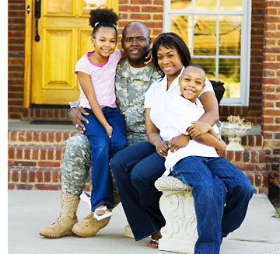
Evaluation of the IL National Guard Event Based Programming (Linnell, Dick, Meyers, Schneider, and Swerdlik, 2010)
Gained new knowledge
Events were relevant and
useful
Greater understanding
and awareness of resources and services.
“One Size does not fit all”
More positive community support associated with positive reintegration experience
Stronger family support associated with more positive reintegration experience.
Notes:
Our initial collaborative project, lead by school psychology doctoral students Jake Linnell and Silas Dick, with the National Guard involved conducting a program evaluation of early Illinois Yellow Ribbon program-at the time few programs included an evaluation component conducted by an independent body.
The primary goal of this study was to evaluate the perceived usefulness and participant satisfaction with the Illinois National Guard Reintegration program one of the first in the nation. Additionally, this study sought to determine self-reported mental health. The study also evaluated many aspects of the Reintegration program to determine strengths and weaknesses of the program.
Our findings included that participants gained new knowledge related to reintegration process
Events were relevant and useful to soldier’s readjustment to civilian life
Soldiers reported a better understanding and awareness of certain resources and services at the second evaluation point.
One Size does not fit all-for example, married soldiers have different needs than single soldiers, more recent changes in the program include a) emphasizing smaller events, bringing in more local resources, and having more opportunities to service members and families to process their experiences in peer groups
Our research also reinforced the importance of social support including support beyond the family
Soldiers who reported positive community support (someone who they did not know thanked them for their service) reported a more positive reintegration experience than those who did not
Soldiers who reported that their family members were proud of them for being a war veteran also reported a more positive reintegration experience (hero status discussed previously)

Slide 41
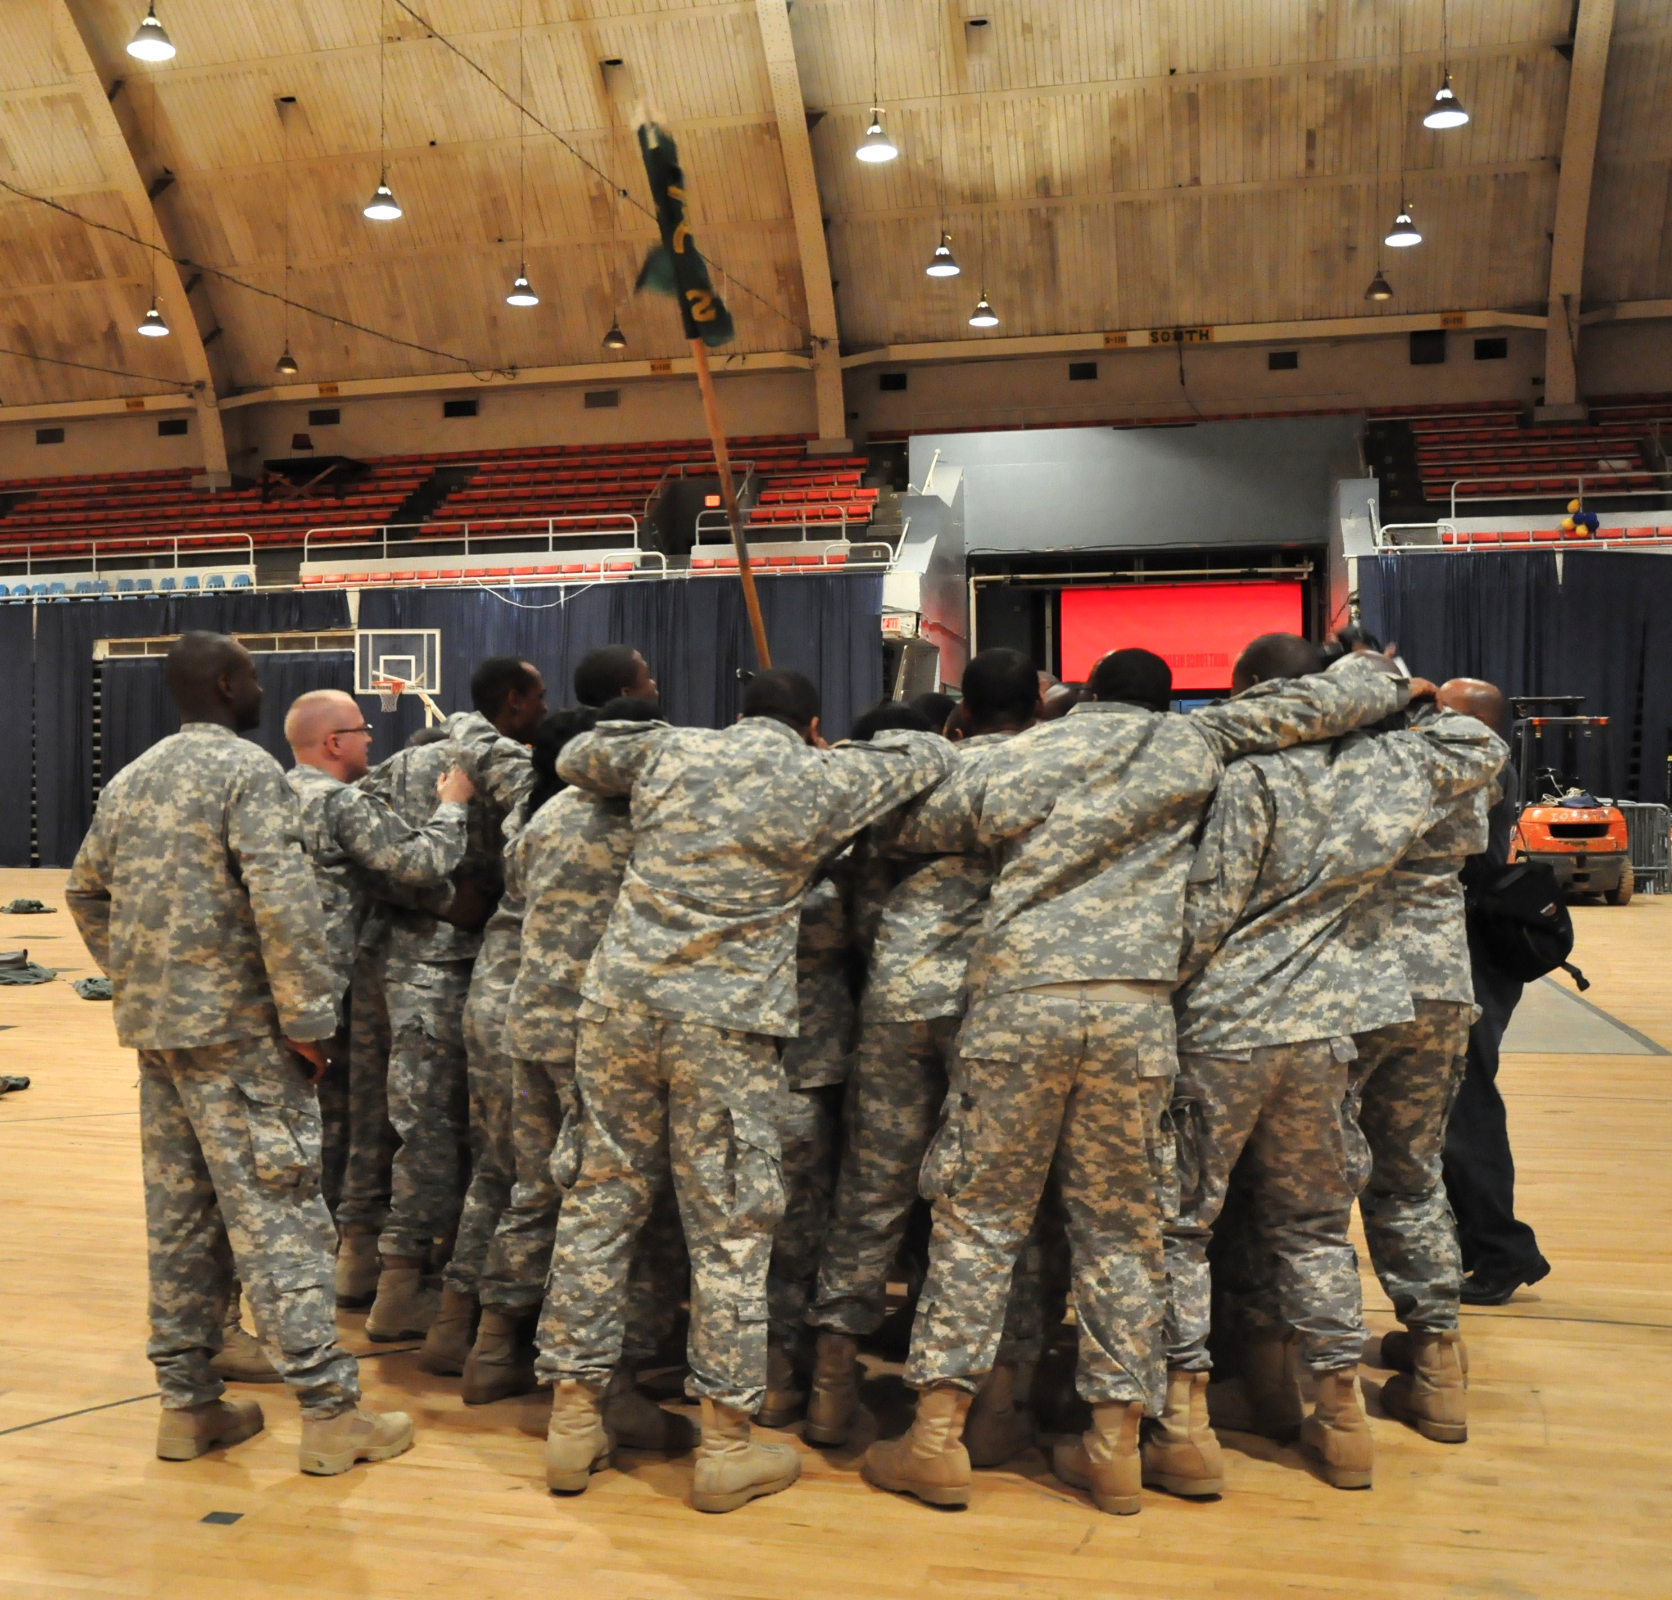
Peer Outreach Support Program (Warrior to Warrior Program)
Use of volunteer veterans who are assigned to National Guard units
Attend on drill weekends
Under supervision of mental health professionals
Goals:
Increase soldier awareness of common
reintegration challenges
Increase awareness of the resources
Promote appropriate treatment use
Reducing stigma (confidentiality-impact
on promotions, perceptions of being
weak
Notes:
Another approach to reintegration programming is termed Peer Support.
A program developed by Michigan National Guard called BuddytoBuddy and implemented in IL as Warrior to Warrior. Use volunteer veterans who are deployed to units during drill weekends and who provide more intensive support, treatment matching, and referral. These volunteer veterans Meet weekly with mental health specialist through conference calls.
Hypothesized to facilitate care by reducing stigma (concerns about confidentiality negatively impacting promotion opportunities in the military, concern what peers will think-perceive solider seeking treatment as weak), , providing increased social support, and modeling positive attitudes towards care

Slide 42
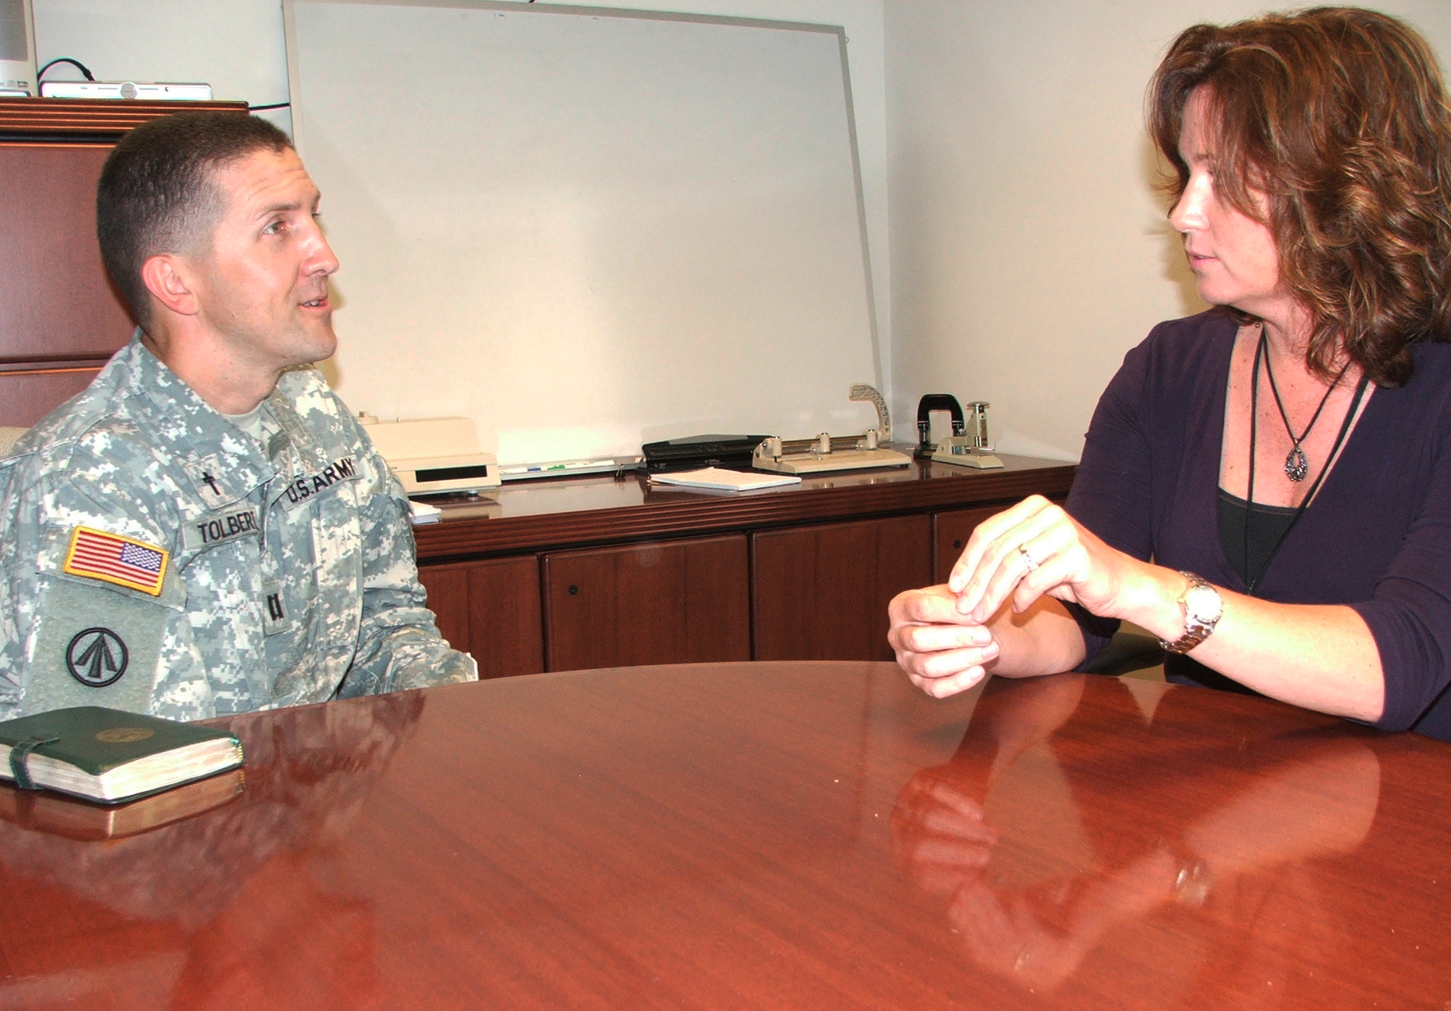
Civilian Mental Health Counselors: What is most important to Soldiers? (Jensen, Swerdlik, Kahn, Gluth, and Disandro, 2012)
Rated most important
Counselor Experience and
Military Knowledge
2. Counselor Professionalism
Office Setting
Counselor Affirmation of Pro-Military Attitudes and Communication of Pro-Military Values
Notes:
With this high need, the number of military personnel needed to provide mental health services is expected to strain the capacity of the Veteran’s Administration to respond, so civilian mental health practitioners or community providers will need to provide services and can also address the barriers of confidentiality, what others think. A lot of different opinions exist on what soldiers are looking for in their mental health providers and if they have children, characteristics of mental health providers they desire for their children. Conducted a study to begin to answer this question in the hope it would help soldiers seek and remain in treatment.
We surveyed 212 soldiers at 30 and 60 day Yellow Ribbon events.
looked at clusters of mental health provider characteristics-
Items fell into four clusters-In order of importance-
Experience and military knowledge was rated as most important, this was followed by Professionalism. Office setting came in next and affirmation of and communication of promilitary attitudes and values were rated as least important with respect to the other clusters.
Knowledge and Experience most important Items represent best measures
Knowledge –Items rated as most important on this component include formal counselor training (specialty training in knowledge of and treating common mental health issues faced by returning service members), understanding of challenges associated with service members returning from deployment and reintegrating into their families and communities, and experience working with soldiers and their families.
Professionalism: Availability of the counselor, Level of Respect and Empathy
Office Setting –generally not rated as important as other factors. The highest rated item in this cluster involved personal hygiene. Here, the soldiers rated having the counselor maintain a clean, well-groomed appearance as important. Other items in the cluster, such as having a small and quiet waiting room was rated as not as important.
Affirmation of Pro-Military Attitudes and Communication of Pro-Military Values-were not rated as not as important. This cluster included items like “attends events in the community that show support of the military”; “communicates supportive views of the military”, and “validates the soldier’s own personal political views” Items like verbally communicates respect for the military and it’s values loads on both general professionalism and counselor experience and affirmation of pro-military values

Slide 43
Take Home Points
War is synomous with fear, aggression, loss, anguish, and confronting both visual and emotional challenges.
Cumulative length of deployments increase, resiliency is waning
Reintegration is a process and not an event.
Different reintegration experience for National Guard/reservist veterans and their families as compared to active military.
Most soldiers adjust satisfactorily but for as many as 33% of our war veterans there exists a significant mental health impact of war
There exists common challenges during reintegration
Notes:
Now like to conclude with some Take Home Points
*As Civil War General Tecumseh Sherman said “ War is Hell” although I have never participated in combat and cannot really know what it is like from my readings and talking with veterans Modern War is also Hell and synonymous with fear, aggression, loss, anguish, and confronting both visual and emotional challenges. IN FACT MAY MORE CHALLENGING DUE TO NO FRONT LINES AND ENEMY DOES NOT WEAR UNIFORMS
As the cumulative length of deployments increases, resiliency is waning-Cumulative length of deployments are historically at an all time high
*Reintegration back to civilian life is a process and not an event. Predictable phases
Different reintegration experience for National Guard/reservist veterans and their families as compared to active military. Not as easy to access peer support and medical/mental health services dependent on community resources and services.
*Most adjust satisfactorily but for as many as 33% of our war veterans there exists a significant mental health impact of war . Higher for National Guard and reservist war veterans.
There exists common challenges during reintegration
A relationship exists between parental deployment and child mental health outcomes but uniformly small with much individual variation-so many children are having adjustment issues-find if family adjusts well so do the kids.

Slide 44
Take Home Points
A relationship exists between parental deployment and child adjustment
Involvement and support from family members plays an important role
Importance of social support from non-family members (e.g., friends) for successful reintegration
Significant Impact of whole community on successful reintegration experience.
WE ALL HAVE A ROLE TO PLAY
Notes:
A relationship exists between parental deployment and child adjustment. Need more research on protective factors that build resilency.
* Family support has a significant impact on a soldier’s readjustment and family preparedness for deployment leads to better adjustment during and post-deployment.
*Community and social support play a very important role in a both a family’s ability to successful cope with a family member’s deployment and the soldier’s successful transition to life at home after wartime service.
WE ALL HAVE A PART
.
.
.

Slide 45
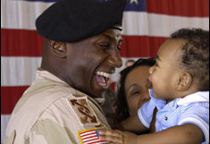
Notes:
Hope by reviewing with you this evening some of the psychological research related to challenges faced by soldiers and their families as well as some of the approaches the military and others are taking to address them, will encourage you to help strengthen the yellow ribbon for our soldiers and their families by committing, as Jill Biden writes in her children’s book Don’t Forget God to Bless our troops, a simple act of kindness to a military family.
SUCH AS OFFER TO HELP WITH CHILD CARE TO PROVIDE THE SINGLE PARENT A RESPITE-HELP CHILDREN AS THE BETER THE PRIMARY CARETAKER OF THE FAMILY COPES WITH THE STRESSES OF DEPLOYMENT THE BETTER THE CHILDREN COPE
HELP WITH HOUSEHOLD CHORES-OFFER TO CUT THE GRASS, SHOVEL THE SNOW
SIMPLY SAY THANK YOU FOR YOUR SERVICE AND SACRIFICES TO BOTH THE SOLIDER AND THEIR FAMILY MEMBERS
BE AWARE OF NEEDS OF MILITARY CHILDREN

Slide 46
Notes:
As I come to the end of my talk this evening, I ask for your indulgence for a few more minutes. I have been very blessed to have a long and satisfying career at a single institution, ISU. This longevity resulting from a high level of job satisfaction is attributed to one factor-the people who make up this institution. NEXT SLIDE

Slide 47
Department Chairs
Macon Williams
Larry Alferink
John Pryor
David Barone
Scott Jordan
Notes:
MY DEPARTMENT CHAIRS--Those of us in academia know as a faculty member it is your department chair who can make your work life like walking through a beautiful GARDEN or like being stranded in a DRY HOT DESERT I have been very fortunate to have department chairs who have made my work life WALKING THROUGH A BEAUTIFUL GARDEN.

Slide 50
School Psychology Colleagues
Audrey Grupe
Marge Lewis
Bob Hogan
Jeff Laurent
Kathy Hoff
Gary Cates
Karla Doepke
Steve Landau
Adena Meyers
Renee Tobin
Brenda Huber
Notes:
MY PAST AND CURRENT SCHOOL PSYCHOLOGY COLLEAGUES
I HAVE HAD WONDERFUL COLLEAGUES IN SCHOOL PSYCHOLOGY-THEY ARE AND HAVE BEEN BRIGHT, ARTICULATE, AND PASSIONATE-WE DON’T AGREE ON EVERY ISSUE BUT WE WORK HARD ON COLLABORATIVE PROBLEM SOLVING AND HAVE DEVELOPED A GRADUATE PROGRAM WE ARE ALL PROUD OF

Slide 51
Department Colleagues and Students
Notes:
My FORMER AND CURRENT non-school psychology department colleagues AS A GROUP WHO ARE OUTSTANDING TEACHERS AND PRODUCTIVE RESEARCHERS . I HAVE BEEN PROUD TO BE THEIR COLLEAGUE AND HAVE APPRECIATED THEIR CONTRIBUTIONS TO OUR GRADUATE PROGRAMS IN SCHOOL PSYCHOLOGY AND TO ME PERSONALLY
AND THE MANY CURRENT AND FORMER STUDENTS WHO HAVE BEEN SUCH A JOY TO WORK WITH –I HAVE FOUND THEM SO BRIGHT AND HIGHLY MOTIVATED AND I HAVE TAKEN SUCH PLEASURE OVER THE YEARS IN THEIR SUCCESSES IN THEIR CHOSEN CAREER OF SCHOOL PSYCHOLOGY.
NEXT SLIDE OF FAMILY-

Slide 52
Peggy, Jenny, Danny and son-in-law John
Notes:
And most of all I am grateful to my family including my wife Peggy, daughter Jenny, son Danny, and son-in-law John. I thank them for their support all through my academic career. I am sure each of you recognize anything one accomplishes professionally never occurs in a vacuum rather we all need our families to support us in our work. The members of my family certainly supported me and I am very appreciative and love them very much.. NEXT SLIDE OF GRANDCHILDREN.

Slide 53
Our Twin Grandchildren : Colin and Grace
Notes:
And I don’t want to forget the most recent additions to our family, our twin grandchildren Colin and Grace

Slide 54
QUESTIONS
Notes:
I am happy to entertain ANY questions on the content of my talk

